Slide 1
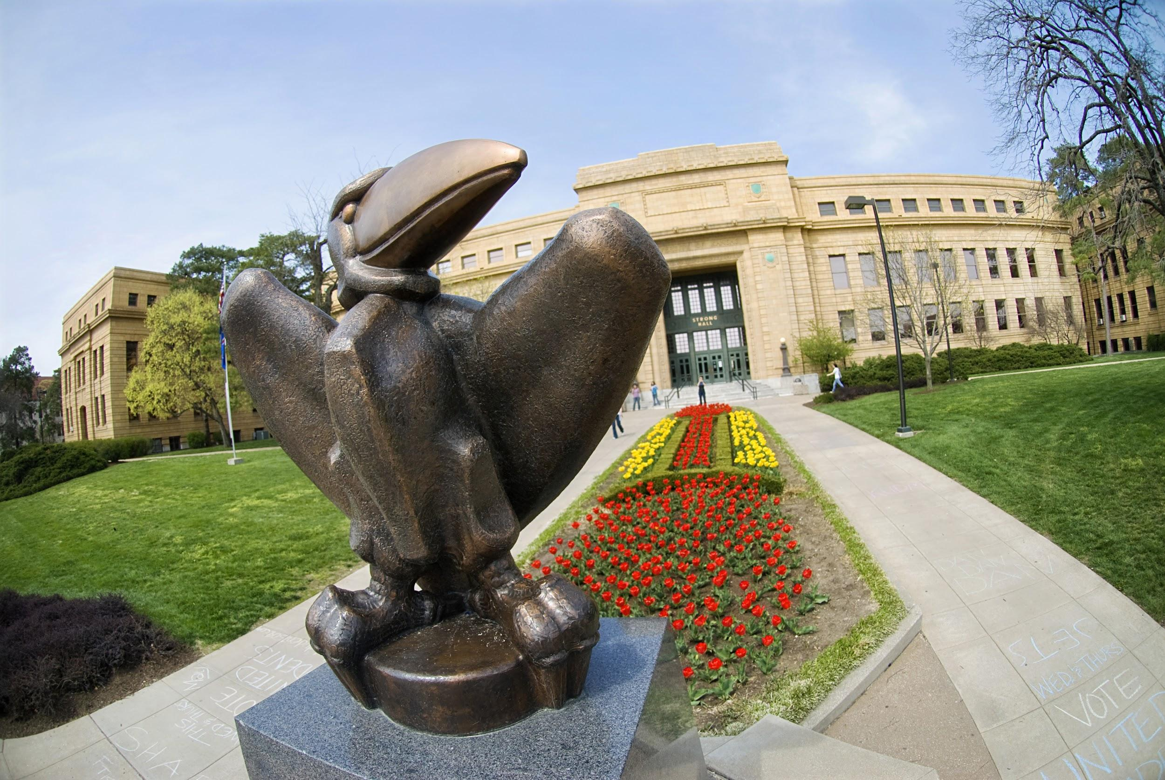
Welcome
Intro to Linux and Cluster Computing
KU Center for Research Computing
Notes:
Welcome everyone, for those who don't know me or don't remember my name is Nick Eggleston, I work for the Center for Research Computing, I work under Dan who most of you probably know.

Slide 2
0 - What is Linux?
1 - I've used Linux once or twice
2 - I can use cd and ls
3 - I prefer Linux over Windows
4 - I grep and awk daily
5 - I run Gentoo and write my own drivers
KU Center for Research Computing
Notes:
Now, just so I’ll know how bad I should feel for making this too hard or too simple, Show of hands, what level is everyone here at
[List numbers]
Hopefully by the time we’re done here, everyone will be at at least at 2, and hopefully we can convince some of you to bump up to a 3

Slide 3
What is Linux
Runs our cluster, and nearly every other HPC world wide
Operating System, just like Windows or MacOS
Completely Free
Open Source - Anyone can view the source and make modifications
Much faster and uses far fewer resources leaving more for computation
KU Center for Research Computing

Slide 4
SSH?
Stands for Secure SHell
Allows you to sign into a Linux machine remotely
Gives the same control as sitting in front of the box
Can see graphical windows using X-Forwarding (ssh -X)
Just because you’ve ssh’d doesn’t mean your files transfer over
Reference:
https://crc.ku.edu/hpc/access
KU Center for Research Computing
Notes:
You may have heard this term thrown around before by us or other cluster/Linux users, but it's one of the most fundamental things you’ll need to understand if you’re planning on using the campus cluster is SSH

Slide 5
(S)FTP
Stands for Secure File Transfer Protocol
Can use WinSCP or Filezilla to move files to and from another Linux machine
Gives remote file access to a machine
At KU you likely won't use this because we have a service called Globus, but it's good information to know
Reference:
https://crc.ku.edu/hpc/storage#Transfer
KU Center for Research Computing
Notes:
Demo WinSCP to show remote file access

Slide 6
Basic Navigation
pwd - Print working directory
ls - List directory contents
cd - Change directory
. (dot) - Reference to the directory you’re currently in
.. (dot dot) - Reference to the parent directory of the directory you’re currently in
Tab complete - A gift from the Linux gods
KU Center for Research Computing

Slide 7
‘man’ is your friend
man stands for manual
Nearly any command you want to know more about you can type
man <command>
Gives switches and modifiers for command syntax
example: man ls
If that doesn’t work try <command> --help or just plain old Google
KU Center for Research Computing

Slide 8
Common Directories
~ Tilde is your home (cd shortcut)
/home/<username> -or- /usr/local/home/<username>
/etc/
/opt/thingy
$HOME, $WORK, and $SCRATCH, useful but only work for the KU Community Cluster
Reference:
https://crc.ku.edu/hpc/storage
KU Center for Research Computing

Slide 9
File manipulation
mkdir
rm
rmdir (or rm -r)
cp
mv (this also renames)
THERE IS NO ‘UNDO’ so be absolutely sure these commands are what you want
KU Center for Research Computing

Slide 10
Text editing from the command line
Different editors for different styles (nano, vim, emacs)
Nano is simple
Write simple submit scripts, or complex programs
If you’re feeling adventurous, I’d recommend vim
KU Center for Research Computing

Slide 11
*-no longer just for obscuring swear words
The * character is a ‘wildcard’ meaning it can stand in for varying parts of a name
example:
You want to delete files win95.txt, win98.txt, winxp.txt, winvist.txt, win7.txt, win8.txt
You can call rm win*.txt and it will delete everything that follows that pattern
As with any operation, whatever you do in the command line is permanent,
be careful!
KU Center for Research Computing
Notes:
I think it might be obvious why we picked these specific things to get rid of ;)

Slide 12
Environment Variables
Used to save things you’ll need again and again
File paths are a good example
example: export POINT=/home/n227e821/work_stuff/pointwise_stuff
Now I can ‘cd $POINT’ instead of the long path
Works for other things you’d like to store as a variable
All-caps is good practice, but not a requirement
KU Center for Research Computing
Notes:
When you refer to variable names in BASH (which is the shell we’re using) you have to put a $ in front when you refer to them, but not when you assign them. You might remember I mentioned $HOME, $WORK, and $SCRATCH earlier, these are a great example of environment variables we set for you automatically

Slide 13
Useful tools
head View the first n lines of data.
tail View the last n lines of data.
sort Organise the data into order.
nl Print line numbers before data.
wc Print a count of lines, words and characters.
awk Filter
cut Cut the data into fields and only display the specified fields.
uniq Remove duplicate lines.
cat Print data from a file or stream, or concatenate streams/files
tac Print the data in reverse order.
grep Search for a string [or anything really]
sed Search and replace utility
KU Center for Research Computing

Slide 14
Piping and Redirection
Use pipe to send the output of one process to the input of another process
ex: ps aux | grep n227e821
Redirect the output of a process to a file or stream
ex: ps aux > runningProcesses.txt
KU Center for Research Computing

Slide 15
Scripting
All of the commands we’ve covered so far and even more can be combined to make little programs called scripts
You need to use an interpreter to interpret these commands, we use BASH.
Sample:
#!/bin/bash
for WORD in some_list
do
rm $WORD.txt
done
KU Center for Research Computing

Slide 16

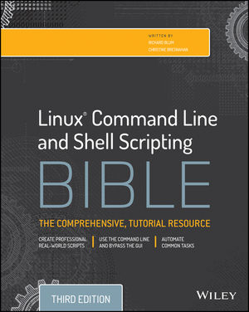
Notes:
If this just fascinated you and you want to know more, these are the best resources I’ve found to learning about these things. They’re super thick books but they’re good reads, I bought a copy of both for myself and not only are they good teaching books but they become excellent reference books for quick questions later down the road. Plus they’re written in a way that you can follow along if you have a Linux system in front of you which luckily all of you now have!

Slide 17
General guidelines on installing software
Load modules you'll need. Compilers, MPI Libraries, and dependencies
Start an interactive job to install in a similar environment to where the software will run
Keep in mind file system quotas, your home directory is only 100 GB
Makefiles are your new friend, but are fickle
./configure, make, make install
--prefix is a great option
Reference:
https://crc.ku.edu/hpc/software/request
KU Center for Research Computing
Notes:
I'm going to probably use a few terms you haven't heard of in these next two slides, but bear with me, all will become clear soon. There was an iteration of the cluster before the current one where there were over 400 pieces of software with no documentation or expiration date. We didn't know if that software was still in use, how many people were actually using it, and whether it was worth our time to try to maintain it. Because of that we've come to a new philosophy. If a piece of software is going to be used by a whole group of people for a long period of time, it's definitely something we want to support. However if this is just some software you want to try out or you're the only person that's going to use it, we ask that you install it in your home or work directory that way if you leave or decide you don't like this program anymore we're not left wondering whether we still need to provide support for the program

Slide 18
General guidelines on installing software - cont'd
Not all software is created equal. Some may come precompiled for you.
Check for a "bin" directory, that's where treasures lie
If you need help, give us as much information as you can
Reference:
https://crc.ku.edu/hpc/software/request
KU Center for Research Computing
Notes:
In elementary school my art teacher had a policy, "ask three before you ask me". Basically she didn't want to be inundated with a bunch of elementary school kids who weren't paying attention when she gave instructions, so if you had a question you were supposed to ask three of your classmates and if none of them had the answer then you could ask the teacher. Now we're not going to be like that, if you have a question you can definitely feel free to ask us and we'll help you as best as we can. But it's always a good idea to talk to people in your research group first if you're having a problem because they may have more domain expertise on an issue than we do, also they are likely to be able to get back to you much quicker than we can just given the sheer amount of stuff we have to deal with on a daily basis. This is good advice for all your cluster related issues, not just installing software, but this felt like a good slide to include this.

Slide 19
And now what you’ve all been waiting for...

Slide 20


What is a cluster?
Notes:
The more I give this talk, I've come to realize that people's understanding of how a cluster works varies wildly, so I'm going to give a quick rundown of what actually makes up a cluster to hopefully give you a better background of what all we're about to talk about.
Imagine you're doing a jigsaw puzzle. And you pick up a piece and you try to find another piece that goes with it. And you do that over and over again, for 1000 times and ta-da your puzzle is complete. But now imagine one of your friends comes over and you give your friend what I'll call an "ideal half" of the pieces, that is each pile only contains the pieces that go together. So, except for the little bit at the end where you have to join the two halves together, you'd be done in half the time as just you working by yourself. Now imagine 2 more of your friends come over. Now there's 4 of you! With all 4 of you having ideal piles, you'll be done in roughly a quarter of the time it would have taken otherwise. This is exactly the magic of the cluster.
Normally when you set your laptop or desktop to solving a problem, there's just one "thinker" working on solving the puzzle. But when you give the problem to the cluster, you all of a sudden have access to over 300 "thinkers" to work on smaller segments of your problem simultaneously. This is the concept of parallelism and it's something clusters are VERY good at.

Slide 21
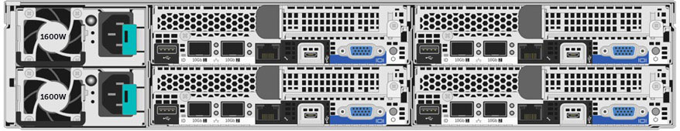
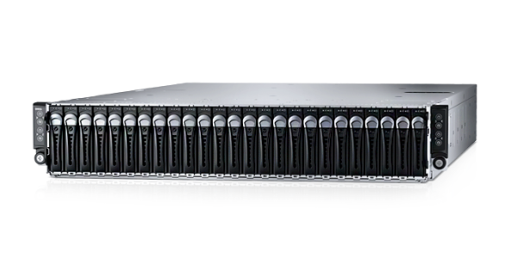
Notes:
The next hurdle I've noticed a lot of people have is they can't seem to come up with a mental image of what something like this would even look like. So this is a Dell PowerEdge C6320. This or machines that look pretty much exactly like them is what makes up the vast majority of the KU Community Cluster. Each of these boxes houses 4 individual computers. And we take a whole bunch of these and network them all together...

Slide 22
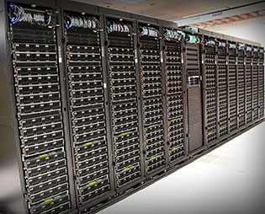
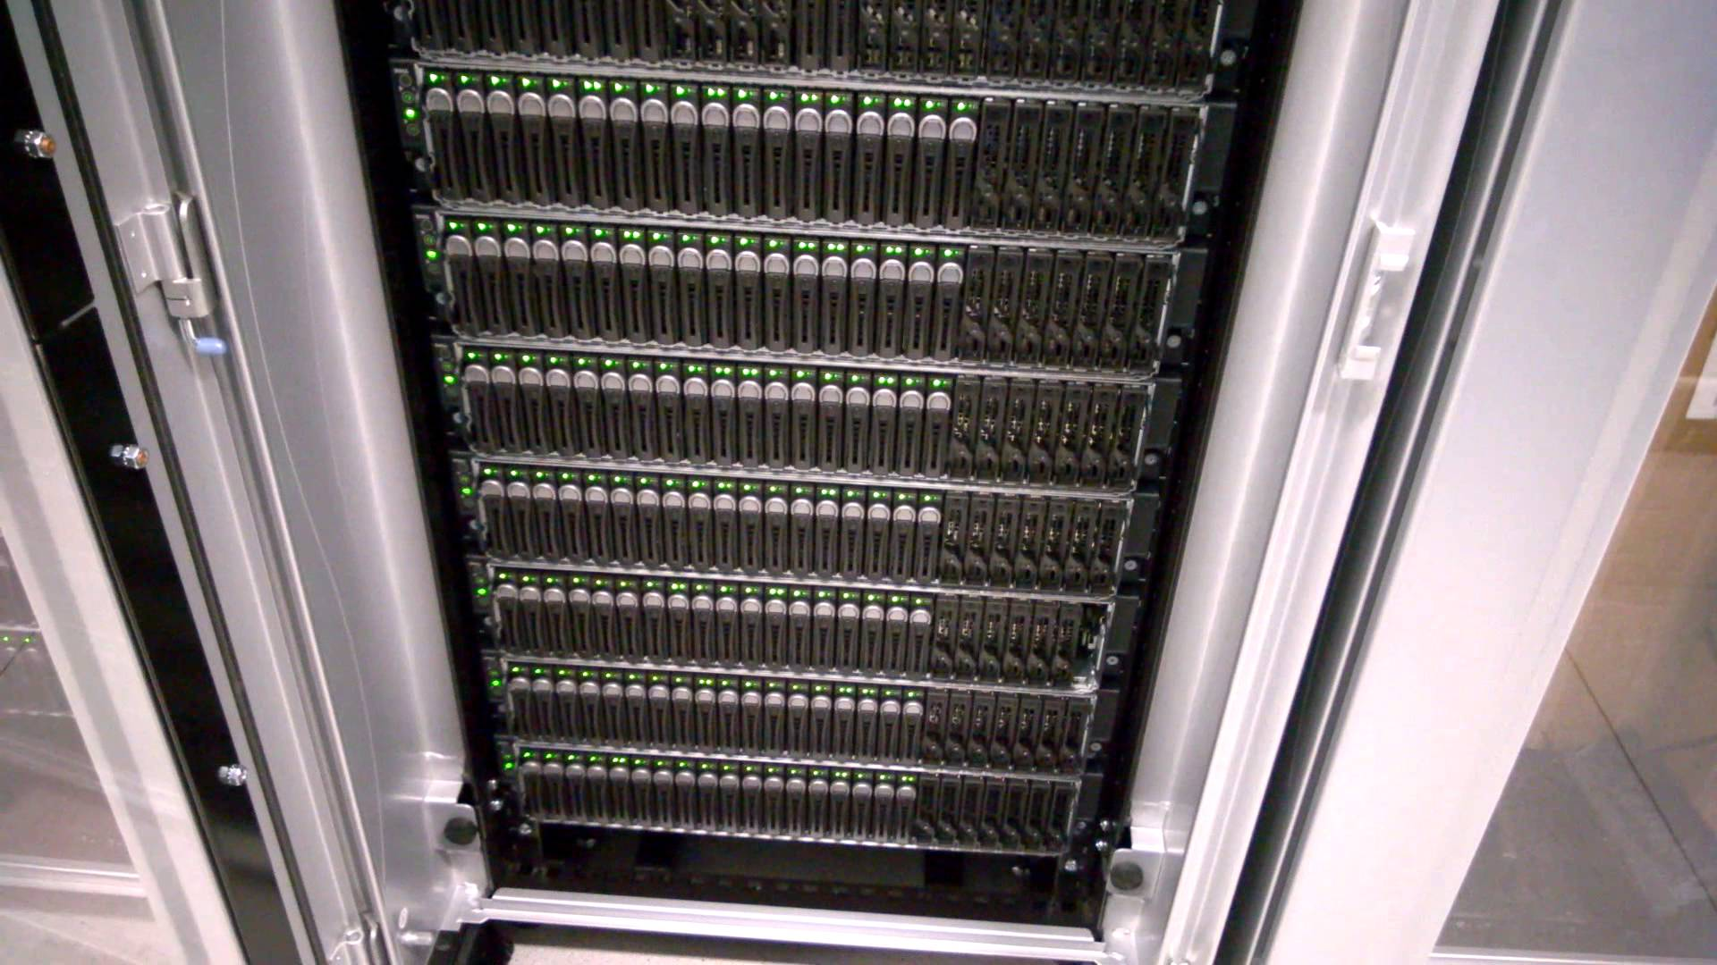
Notes:
...and we put a bunch of them in a rack and then we put a whole bunch of the racks in a room with lots of cooling and electricity and some high speed networking and some super fast storage and we call it a cluster.

Slide 23
Your
laptop
submit1
admin
submit2
KU Community Cluster
compute3
+
Xeon Phi
compute1
+
GPU
compute2
compute4
compute5
Notes:
You'll have to forgive me for this slide, they don't pay me for my art talents. This is a bit of an over simplification but hopefully it will illustrate the path your job will take and how the cluster is laid out.

Slide 24
Account Creation
You get access to what you (or your group) paid for
We want to have accurate record keeping for everyone
Fill out the form at the link below
Reference:
https://crc.ku.edu/hpc/access
KU Center for Research Computing
Notes:
We want to make sure that anyone using the cluster is *supposed* to be using the cluster and is only running where they're supposed to be running. Because of that we've implemented a few access controls to make sure we know who's who, and assign you to the proper set of hardware.
That link at the bottom goes into a little more detail about getting new accounts setup, what forms to fill out, and how to get accounts for non-KU collaborators. Well worth a read.

Slide 25
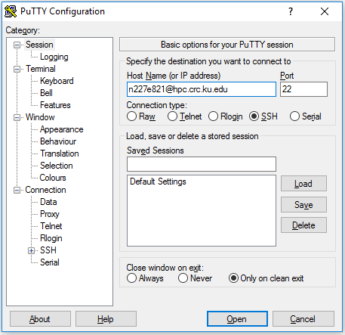
SSH cont’d
Windows: Open PuTTY
Host Name (or IP address): <KU Online ID>@hpc.crc.ku.edu
Mac and Linux: Open Terminal
ssh <KU Online ID>@hpc.crc.ku.edu
Reference:
https://crc.ku.edu/hpc/access#Connecting
KU Center for Research Computing

Slide 26
Cluster Specific Commands
module avail, module load, module list
#MSUB All commands within the job file
msub Command on the cluster to submit a job file
msub -I Start an interactive shell on a compute node
showq / qstat How to check the status of your job
canceljob / qdel How to cancel your job
Reference:
https://crc.ku.edu/hpc/how-to
KU Center for Research Computing
Notes:
We'll talk about the module commands more in the next slide, for now this is just for you to know they exist as "cluster specific commands". The rest of these are hopefully self documenting, but we'll go through them

Slide 27
Loading software
Why modules?
module list - lists all the modules you currently have loaded
module avail - lists all the available software, note: this is semi-dynamic
module load - allows you to load a new piece of software
Look out for compiler conflicts and dependencies
Reference:
https://crc.ku.edu/hpc/software
KU Center for Research Computing
Notes:
Modules are a handy system that allow us to have multiple versions of the same software installed on the cluster and then allow you to pick only the pieces and versions of software that you need to use.
List, avail, load demo
Certain pieces of software must have the Intel or GCC compilers and so the module avail will change a little based on which compiler you have loaded. Other pieces of software will just chain load the compiler they were compiled with automatically, if you end up needing a different compiler for your work, let us know and we'll work to make that happen

Slide 28
Queues
Each group that purchased hardware gets at least one queue
Queue covers all hardware your group purchased, requesting specialty nodes done with flags in submit script
Special 'sixhour' queue exists for submitting jobs to anywhere on the cluster. Runs at a lower priority and can only run for <= 6 hours.
#MSUB -q sixhour
showq -w class=<queue_name> will show you all the jobs running in a given queue
Your default queue is shown on login and by running mystats
Default: 1 core, 2GB memory, 1 hr walltime (sixhour), 8hr walltime (owner queue)
Reference:
https://crc.ku.edu/hpc/how-to#Queues
KU Center for Research Computing
Notes:
[READ THIS PART FIRST] Remember all those circles a few slides back? Well each of those yellow circles corresponds to a set of hardware that has a queue assigned to it. By default your jobs will start on the hardware of the group that you're a part of. [Explain sixhour queue].

Slide 29
Sample Submit Script
#!/bin/bash
#MSUB -N MyJob
#MSUB -l procs=48,pmem=48m,walltime=05:00
#MSUB -m abe
#MSUB -M crchelp@ku.edu
#MSUB -j oe
module load compiler/gcc/6.3
module load openmpi/2.0
mpirun $HOME/myprogram.out
Reference:
https://crc.ku.edu/hpc/how-to#Script
http://docs.adaptivecomputing.com/9-1-0/MWM/help.htm#topics/moabWorkloadManager/topics/moabCommands/commands/msub.html
KU Center for Research Computing

Slide 30

Viewpoint and RemoteViz
Reference:
https://crc.ku.edu/hpc/how-to#Viewpoint
KU Center for Research Computing
Notes:
I'll assume that a good majority of you in here have taken calculus. For those of you who haven't, you probably won't get this joke and I'm sorry, I'll try to come up with a less nerdy joke next time :). For those of you that did take calc I, do you remember doing a derivative by definition, how frustrating that was but how well it actually illustrated how a derivative actually worked? Well everything we have talked about up to this point is kind of like doing a derivative by definition. But now we're going to take the easy way out and move our exponent down in front, and open our browser to this shiny new product called Viewpoint. Viewpoint allows you to do pretty much everything you can do with a traditional command line interface and submit scripts but allows it all to be done with buttons and text boxes in the browser.
Like I said before it's not quite ready to be released into the wild just yet, we want to make sure we give you guys the most stable and professional experience with all the tools we release, but here's a little preview of what you can look forward to
It's pretty slick, and because live demos always go so well, we're going to try one now
Workload tab, shows all running and queued jobs, kind of like a pretty showq/qstat
Nodes tab, shows all nodes in the cluster, how busy they are, what queues they're in and the features they have
Templates allows you to create a template job, something that you'd submit over and over with only minute changes
File manager tab, actually works and shows the files currently in your home/work/scratch directories and even allows you to upload
Remote Viz demo
Now lets create a job.

Slide 31
Recap & useful links
https://crc.ku.edu/hpc/access
https://crc.ku.edu/hpc/how-to
https://crc.ku.edu/hpc/storage
http://docs.adaptivecomputing.com/9-1-0/MWM/help.htm#topics/moabWorkloadManager/topics/moabCommands/commands/msub.html
KU Center for Research Computing

Slide 32
Questions?
Find these slides at: https://goo.gl/WC4qVx
Email us at crchelp@ku.edu

