Slide 1
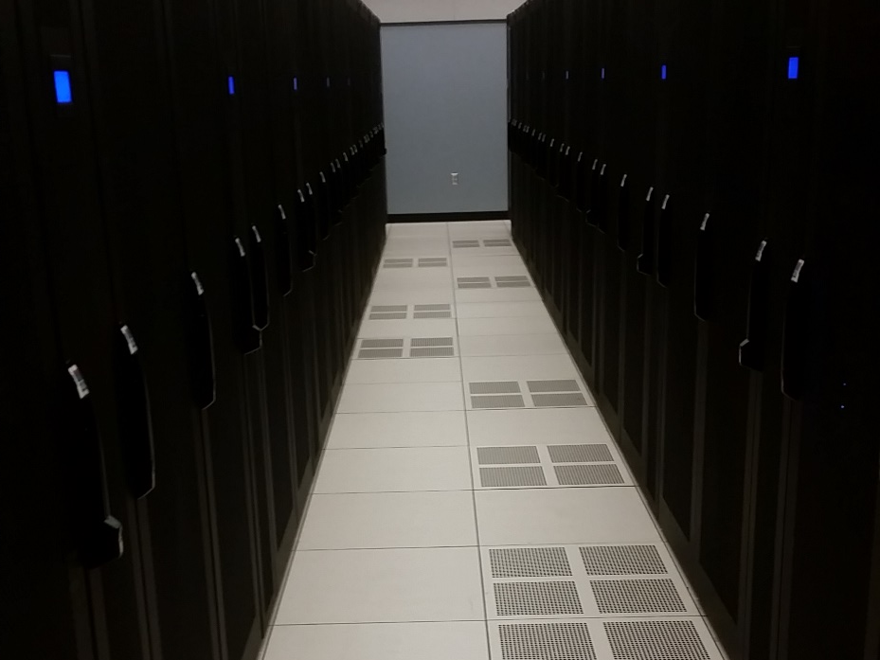
Welcome
Compiling Software, Modules, Conda, and R packages

Slide 2
Software
What happens when you ‘apt-get install’ or
‘yum install’?
Debian - .deb / Red Hat - .rpm
.deb and .rpm files are just a collection of pre-compiled files and copied to specific locations
View contents of .rpm with ‘rpm –qlpv’

Slide 3
Software
rpm -qlp jags4-4.1.0-65.2.x86_64.rpm
warning: jags4-4.1.0-65.2.x86_64.rpm: Header V3 DSA/SHA1 Signature, key ID bf27c617: NOKEY
/usr/bin/jags
/usr/lib64/JAGS
/usr/lib64/JAGS/modules-4
/usr/lib64/JAGS/modules-4/basemod.la
/usr/lib64/JAGS/modules-4/basemod.so
/usr/lib64/JAGS/modules-4/bugs.la
/usr/lib64/JAGS/modules-4/bugs.so
/usr/lib64/JAGS/modules-4/dic.la
/usr/lib64/JAGS/modules-4/dic.so
/usr/lib64/JAGS/modules-4/glm.la
/usr/lib64/JAGS/modules-4/glm.so
/usr/lib64/JAGS/modules-4/lecuyer.la
/usr/lib64/JAGS/modules-4/lecuyer.so
/usr/lib64/JAGS/modules-4/mix.la
/usr/lib64/JAGS/modules-4/mix.so
/usr/lib64/JAGS/modules-4/msm.la
/usr/lib64/JAGS/modules-4/msm.so
/usr/lib64/libjags.la
/usr/lib64/libjags.so.4
/usr/lib64/libjags.so.4.0.1
/usr/lib64/libjrmath.la
/usr/lib64/libjrmath.so.0
/usr/lib64/libjrmath.so.0.0.0
/usr/libexec/jags-terminal
/usr/share/man/man1/jags.1.gz

Slide 4
Software
Usually a regular package and ‘-devel’ package
  ‘-devel’ has header files to compile other packages against
jags4-4.1.0-65.2.x86_64.rpm
jags4-devel-4.1.0-65.2.x86_64.rpm

Slide 5
Software
Most commonly used commands
  ./configure --prefix=/path/to/where/you/want
  make
  make install
Usually there is a INSTALL or README file located in the source files

Slide 6
Software
Set up directories for source, sw, and modules. Not necessary, but helps with organization
./src/<package.tgz>
./sw/<package>/<version>
  ./sw/jags/4.1.0
  ./sw/jags/4.2.0
./sw/modules/<package>/<version>.lua
  ./sw/modules/jags/4.1.0.lua
  ./sw/modules/jags/4.2.0.lua

Slide 7
Software
You should use $WORK or $HOME, but I’ll be using $SCRATCH
$SCRATCH=/panfs/pfs.local/scratch/crc/r557e636
mkdir -p $SCRATCH/../sw/jags/4.1.0
mkdir -p $SCRATCH/../src
mkdir -p $SCRATCH/../sw/modules/jags

Slide 8
Software
cd $SCRATCH/../src
  Get Source Files and copy to your src directory
tar zxvf JAGS-4.1.0.tar.gz
cd JAGS-4.1.0
mkdir build && cd build
../configure --prefix=$SCRATCH/../sw/jags/4.1.0

Slide 9
Software
configure: error: "You need to install the LAPACK library“
You may need to install a dependency before installing this software
  Most ‘-devel’ packages are installed on submit and compute nodes
    openssl, zlib, libcurl, tk, and etc…

Slide 10
Software
Remove files in build directory to start fresh
rm config.log
module load lapack/3.7.1
../configure --prefix=$SCRATCH/../sw/jags/4.1.0
make –j8
make –j8 install
  “-j8” instructs the compiler to use 8 threads to compile. Faster, but could cause hardship for debugging compile errors. Remove if it does not compile.

Slide 11
Software
See configure options to include a certain feature
  ./configure --help
If compile fails on make, clean up using:
  make clean
    not all Makefiles have this
ls –l ./sw/jags/4.1.0
total 320
drwxrwsr-x 2 r557e636 crc_it 4096 Jul 11 21:56 bin
drwxrwsr-x 3 r557e636 crc_it 4096 Jul 11 21:56 include
drwxrwsr-x 4 r557e636 crc_it 4096 Jul 11 21:56 lib
drwxrwsr-x 2 r557e636 crc_it 4096 Jul 11 21:56 libexec
drwxrwsr-x 3 r557e636 crc_it 4096 Jul 11 21:56 share

Slide 12
Modules
module load <package>
  Changes your environment based on the module
module show <package>
  Shows what environment variables the module is changing
module use /path/to/location
  Adds path so that module command can see the modules in that path to load

Slide 13
Modules
Template module file to copy and use
  /panfs/pfs.local/software/install/modulefiles/template.lua
local help_message = [[
JAGS 4.1.0
JAGS library for Bayesian modelling using MCMC.
]]
help(help_message,"\n")
whatis("Name: JAGS")
whatis("Version: 4.1.0")
prepend_path("LD_LIBRARY_PATH", "/panfs/pfs.local/scratch/crc/sw/jags/4.1.0/lib")
prepend_path("MANPATH", "/panfs/pfs.local/scratch/crc/sw/jags/4.1.0/share/man")
prepend_path("PATH", "/panfs/pfs.local/scratch/crc/sw/jags/4.1.0/bin")
prepend_path("INCLUDE", "/panfs/pfs.local/scratch/crc/sw/jags/4.1.0/include")
prepend_path("PKG_CONFIG_PATH", "/panfs/pfs.local/scratch/crc/sw/jags/4.1.0/lib/pkgconfig")
setenv("JAGS_PREFIX", "/panfs/pfs.local/scratch/crc/sw/jags/4.1.0")
setenv("JAGS_LIBDIR", "/panfs/pfs.local/scratch/crc/sw/jags/4.1.0/lib")

Slide 14
Modules
How to use that module file we created
  $SCRATCH/../sw/modules/jags/4.1.0.lua
module use $SCRATCH/../sw/modules
module load jags/4.1.0
env | grep jags
  Check to make sure appropriate variables have the correct path

Slide 15
R Packages
By default, R wants to create personal library at
~/R/x86_64-pc-linux-gnu-library/<version>
Set alternate personal library with:
  export R_LIBS_USER=/path/to/location
Set shared library with:
  export R_LIBS_SITE=/path/to/location
R searches for packages from personal, R_LIBS_USER, to R_LIBS_SITE
View paths R is looking for packages with:
  > .libPaths()
https://mran.microsoft.com/open/
https://mran.microsoft.com/faq/

Slide 16
R Packages
Launch R with the command:
  R
Install packages in R
  > install.packages(“bitops”)
Install tarball from command line
  R CMD INSTALL package.tar.gz

Slide 17
Conda
anaconda/4.3
Great way to set up an isolated python environment. Some python projects, only suggest using conda to install their package.
Default envs installed at ~/.conda/envs
Can choose python version to use in envs
https://conda.io/docs/_downloads/conda-pip-virtualenv-translator.html
https://conda.io/docs/using/envs.html

Slide 18
Conda
Create shared location of conda environment owner group can use
conda create --prefix $SCRATCH/../conda/envs/thisismyname python=2.7 numpy
#
# To activate this environment, use:
# > source activate /panfs/pfs.local/scratch/crc/conda/envs/thisismyname
#
# To deactivate this environment, use:
# > source deactivate /panfs/pfs.local/scratch/crc/conda/envs/thisismyname
#

Slide 19
Questions?
Email us at crchelp@ku.edu
https://crc.ku.edu
Will send link to these slides

